Slide 1
Examine the clusters in Tableau
Launch Tableau
Connect (to a file) > Text file > “UniversitiesWithClusterMembership.csv”

Slide 2
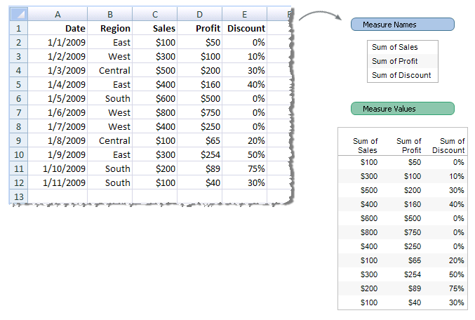
http://kb.tableausoftware.com/articles/knowledgebase/measure-names-and-measure-values-explained

Slide 3
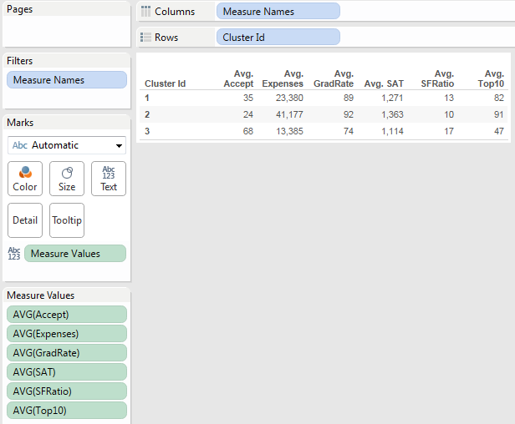
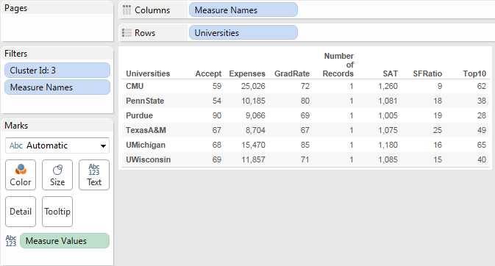
1. What are the average acceptance rate, tuition fees, etc., across clusters?
2. What universities are there in those clusters?
Tableau instructions in the next page
Can you name/label those clusters?
Notes:
Show this on Sheet 1

Slide 4
Tableau Instructions
Click on text tables from the right panel
Move Cluster ID to Rows area
Move Measure Names to Columns area
Move Measure Values to Detail area
Change the SUM to AVG for all measures, except for the Number of Records

Slide 5
Tableau Instructions
Duplicate the current worksheet (right-click > Duplicate Sheet)
Move Univ to Rows area
You may filter on Cluster ID

Slide 6
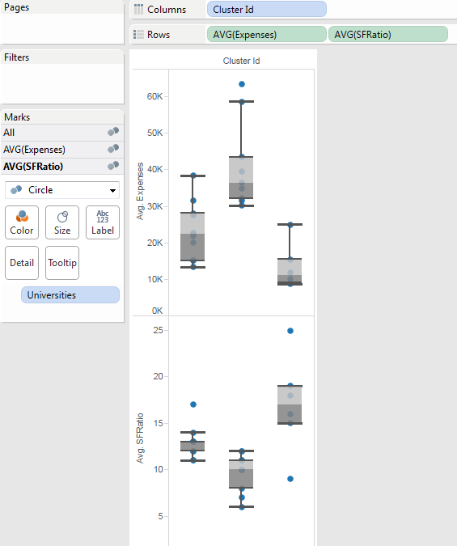
Insights in terms of distribution, outliers?
Tableau instructions in the next page
Notes:
Click on Box plots

Slide 7
Tableau Instructions
Create a new worksheet
Move Cluster ID to the Columns area
Move Measure Values to the Rows area
Move Measure Values to the Filter area > select Expense and SFRatio
Change the SUMs to AVGs.
Universities in the Details area
Click on box-and-whisker plot from the right panel
Interquartile range (IQR) = Q3-Q1;
Lower Whisker/ lower adjacent value (LAV) = smallest observation that is greater than or equal to lower inner fence (LIF=Q₁ - 1.5 * IQR)
Upper Whisker/ upper adjacent value (UAV) = largest observation that is less than or equal to the upper inner fence (UIF=Q₃ + 1.5 * IQR)

Slide 8
Tableau instructions in the next page

Slide 9
Tableau Instructions
Create a new worksheet
Drag Cluster ID on color
Drag Avg(Expense) on Size
Drag Univ on Label
Drag Avg(SFRatio) on Label
Click on Bubbles chart

Slide 11
Examine the clusters in Tableau
Copy-Paste the cluster ID column in HC_Clusters2 to Universities worksheet
Save the file as “Universities_Clustering – with solution.xlsx”
Open Tableau
  Connect to data > Microsoft Excel > choose file “Universities_Clustering – with solution.xlsx” > choose worksheet “Universities” > Import all data

Slide 12
You may also use Excel Data Filter combined with SUBTOTAL function in Excel

